Slide 1


Modern Operating Systems
Fifth Edition
Chapter 2
Processes and Threads
Dr. Xiaoyuan Suo
Webster University
Copyright © 2023, 2014, 2008 Pearson Education, Inc. All Rights Reserved
Notes:
If this PowerPoint presentation contains mathematical equations, you may need to check that your computer has the following installed:
1) MathType Plugin
2) Math Player (free versions available)
3) NVDA Reader (free versions available)

Slide 2
Disclaimer
I included all slides here,
  They are references for you.
  But I won’t go through all slides due to the limited class time.

Slide 3
Processes and threads
Introduction to Processes
  The Process Model
  Process Management
  Process States
  Threads
  Signal Handling
Inter-Process Communication
  I P C Mechanisms
  Classical I P C Problems
Scheduling

Slide 4
The Process Model
Process = Program in execution
How many processes for each program?
A fundamental operating system abstraction
Allows the O S to simplify:
  Resource allocation
  Resource accounting
  Resource limiting
O S maintains information on the resources and the internal state of every single process in the system

Slide 5
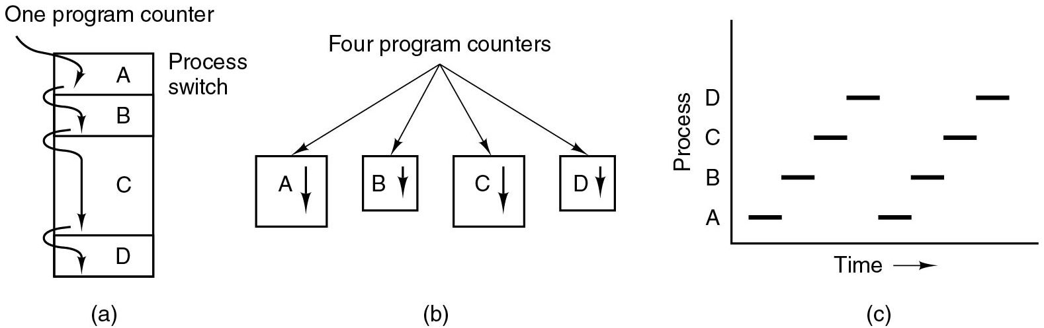
The Process Model (1)
Single program counter
Each process in unique location
C P U switches back and forth from process to process
Figure 2.1 (a) Multiprogramming of four programs.
Notes:
Long description:
Part (a): A vertical rectangular block labeled One program counter has four partitions, out of which the third partition is large. The partitions from top to bottom are labeled A, B, C, and D. Partition A is labeled Process switch. Four downward arrows point to each block individually, starting from one program counter to A, A to B, B to C, and C to D.

Slide 6
The Process Model (2)
Each process has own flow of control
(own logical program counter)
Each time we switch processes, we save the program counter of first process and restore the program counter of the second
Figure 2.1 (b) Conceptual model of four independent, sequential processes.
Notes:
Long Description:
Part (b): Four vertical rectangular blocks have arrows starting from a point labeled Four program counters. The four blocks are labeled A, B, C, and D and all blocks are marked with downward arrows.

Slide 7
The Process Model (3)
All processes make progress, but only one is active at any given time
Figure 2.1 (c) Only one program is active at once.
Notes:
Long Description:
Part (c): Graph: The horizontal axis is labeled Time. The vertical axis is labeled Process. The range of processes is A, B, C, and D. Two sets of horizontal bars are marked at every process in the form of low to high step ladder.

Slide 8
Concurrent Processes
In principle, multiple processes are mutually independent
They need explicit means to interact with each other
The C P U can be allocated in turns to different processes
O S normally offers no timing or ordering guarantees
Notes:
Long Description:
Part (a): A vertical rectangular block labeled One program counter has four partitions, out of which the third partition is large. The partitions from top to bottom are labeled A, B, C, and D. Partition A is labeled Process switch. Four downward arrows point to each block individually, starting from one program counter to A, A to B, B to C, and C to D. Part (b): Four vertical rectangular blocks have arrows starting from a point labeled Four program counters. The four blocks are labeled A, B, C, and D and all blocks are marked with downward arrows. Part (c): Graph: The horizontal axis is labeled Time. The vertical axis is labeled Process. The range of processes is A, B, C, and D. Two sets of horizontal bars are marked at every process in the form of low to high step ladder.

Slide 9
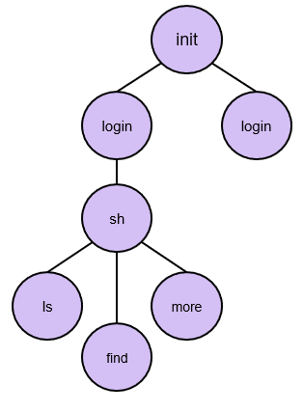
Process Hierarchies
O S typically creates only 1 init process
Subprocesses created independently:
A parent process can create a child process
This results in a tree-like structure and process groups
E.g., shell executes commands:
  $ find /tmp &> t.log &
  $ ls | more
Notes:
Long Description:
From the top, the constituents are as follows. I N I T, login, s h. S h is further divided into l s, find, and more.

Slide 10
Process Creation
Four principal events that cause processes to be created:
  System initialization
  Execution of a process creation system call by a running process
  A user request to create a new process
  Initiation of a batch job

Slide 11
Process Termination
Typical conditions which terminate a process:
  Normal exit (voluntary).
  Error exit (voluntary).
  Fatal error (involuntary).
  Killed by another process (involuntary).

Slide 12
Process Management
fork: create a new process
  Child is a “private” clone of the parent
  Shares some resources with the parent
exec: execute a new process image
  Used in combination with fork
  exec on Windows?
exit: cause voluntary process termination
  Exit status returned to the parent
  Involuntary process termination?
kill: send a signal to a process (or group)
  Can cause involuntary process termination

Slide 13
Process States (1)
Three states a process may be in:
  Running (actually using the C P U at that instant).
  Ready (runnable; temporarily stopped to let another process run).
  Blocked (unable to run until some external event happens).

Slide 14
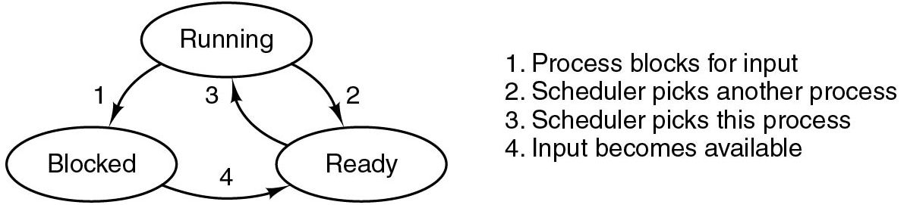
Process States (2)
The O S allocates resources (e.g., C P U) to processes
To allocate the C P U, the O S needs to track process states:
  Running: the process is currently executed by the C P U
  Blocked: the process is waiting for available resources
  Ready: the process is ready to be selected
The scheduler (d e)allocates the C P U (see transitions 2&3)
Figure 2.2 A process can be in running, blocked, or ready state. Transitions between these states are as shown.
Notes:
Long Description:
Transitions between the three states are as shown. There are three oval-shaped blocks labeled Running, Blocked, and Ready. The Running block is placed on top while the other two blocks are placed at the lower left and lower right. There are two downward arrows from running: an arrow labeled 1 points to Blocked and the other arrow labeled 2 points to Ready. An arrow labeled 3 from Ready points to Running block. An arrow labeled 4 from Blocked points to Ready. The description of arrows is mentioned on the right side of the diagram: 1. Process blocks for input. 2. Scheduler picks another process. 3. Scheduler picks this process. 4. Input becomes available.

Slide 15
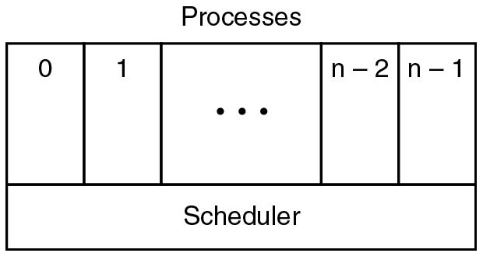
Process States (3)
Scheduler periodically switches processes
Sequential processes lay on the layer above
This leads to a simple process organization
What are the missing fundamental O S abstractions?
Figure 2.3 The lowest layer of a process-structured operating system handles interrupts and scheduling. Above that layer are sequential processes.
Notes:
Long Description:
There is a rectangular block labeled Processes with five vertical partitions and one horizontal partition. The first vertical partition is labeled 0, the second is labeled 1, the third is labeled so on depicted by three dots, the fourth is labeled n minus 2 and the fifth is labeled n minus 1. The horizontal partition is labeled Scheduler.

Slide 16
Information Associated with a Process
I D (P I D), User (U I D), Group (G I D)
Memory address space
Hardware registers (e.g., program counter)
Open files
Signals
This information is stored in the operating system’s Process Table

Slide 17
Process Control Blocks
Process management | Memory management | File management
Registers Program counter Program status word Stack pointer Process state Priority Scheduling parameters Process I D Parent process Process group Signals Time when process started C P U time used Children’s C P U time Time of next alarm | Pointer to text segment info Pointer to data segment info Pointer to stack segment info | Root directory Working directory File descriptors User I D Group I D
Figure 2.4 Some of the fields of a typical process-table entry

Slide 18
Interrupts
Idea: to deallocate the C P U in favor of the scheduler, we rely on hardware-provided interrupt handling support
Allows the scheduler to periodically get control, i.e., whenever the hardware generates an interrupt
Interrupt vector:
  Associated with each I/O device and interrupt line
  Part of the interrupt descriptor table (I D T)
  Contains the start address of an O S-provided internal procedure (interrupt handler)
The interrupt handler continues the execution
Interrupt types: sw, hw device (async), exceptions

Slide 19
Implementation of Processes (2 of 2)
Skeleton of what the lowest level of the operating system does when an interrupt occurs.
  Hardware stacks program counter, etc.
  Hardware loads new program counter from interrupt vector.
  Assembly language procedure saves registers.
  Assembly language procedure sets up new stack.
  C interrupt service runs (typically reads and buffers input).
  Scheduler decides which process is to run next.
  C procedure returns to the assembly code.
  Assembly language procedure starts up new current process.
Every time an interrupt occurs, the scheduler gets control
acts as a mediator
A process cannot give the C P U to another process (context switch) without going through the scheduler

Slide 20
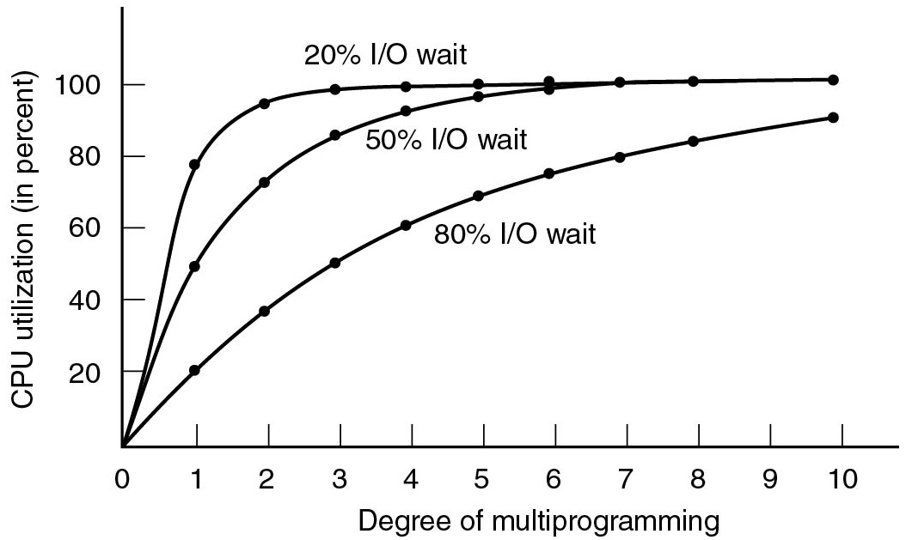
Modeling Multiprogramming
Figure 2.6 C P U utilization as a function of the number of processes in memory.
Notes:
Long Description:
The horizontal axis is labeled Degree of multiprogramming and ranges from 0 to 10 in increments of 1 unit. The vertical axis is labeled C P U utilization (in percent) and ranges from 0 to 100 in increments of 20 units. Three different curves are shown here. The first curve labeled 20 percent I/O wait starts at (0, 0), rises toward the upper right, is concave downward, then rises linearly to the point (1, 80), bends, moves horizontally and ends at (10, 100). The second curve labeled 50 percent I/O wait, starts at (0, 0), rises upward to the right, is concave downward, then merges with the first curve at the point (6, 100) and ends at (10, 100). Several points are marked on this line as follows: (1, 50), (2, 70), (3, 85), (5, 95), and (8, 100). The third curve labeled 80 percent I/O wait starts at (0, 0), rises toward the upper right, is concave upward, and ends at (10, 100). The curve passes through the following points: (1, 20), (2, 40), (3, 50), (5, 70), (6, 75), (7, 80), and (8, 95).

Slide 21
Signal Handling (1 of 2)
Signal types:
  Hardware-induced (e.g., S I G I L L)
  Software-induced (e.g., S I G Q U I T or S I G P I P E)
Actions:
  Term, I g n, Core, Stop, Cont
  Default action on per-signal basis, typically overridable
  Signals can be typically blocked and actions delayed
Catching signals:
  Process registers signal handler
  OS delivers signal and allows process to run handler
  Current execution context needs to be saved/restored

Slide 22
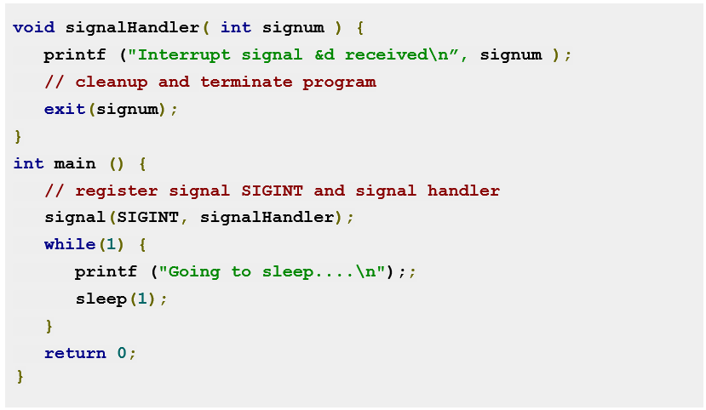
Catching Ctrl-C
Notes:
Long Description:
The code lines from top to bottom are as follows.
void signal handler left parenthesis int signum right parenthesis left brace
print f left parenthesis double quotation interrupt signal and d received backward slash n double quotation comma signum right parenthesis semicolon
double forward slash cleanup and terminate program
exit left parenthesis signum right parenthesis semi colon
right brace
int main left parenthesis right parenthesis left brace
double forward slash register signal S I G I N T and signal handler
signal left parenthesis S I G I N T comma signal handler right parenthesis semicolon
while left parenthesis 1 right parenthesis left brace
print f left parenthesis double quotation going to sleep four dots backward slash n double quotation right parenthesis semicolon semicolon
sleep left parenthesis 1 right parenthesis semicolon
right brace
return 0 semicolon
right brace

Slide 23
Signal Handling (2 of 2)
Kernel delivers signal
Stops code currently executing
Saves context
Executes signal handling code
Restores original context

Slide 24
Threads

Slide 25
Threads
Implicit assumption so far:
  1 process
  1 thread of execution
Multithreaded execution:
  1 process
  N threads of execution
Why allow multiple threads per process?
  Lightweight processes
    Allow space- and time- efficient parallelism
  Organized in thread groups
    Allow simple communication and synchronization

Slide 26
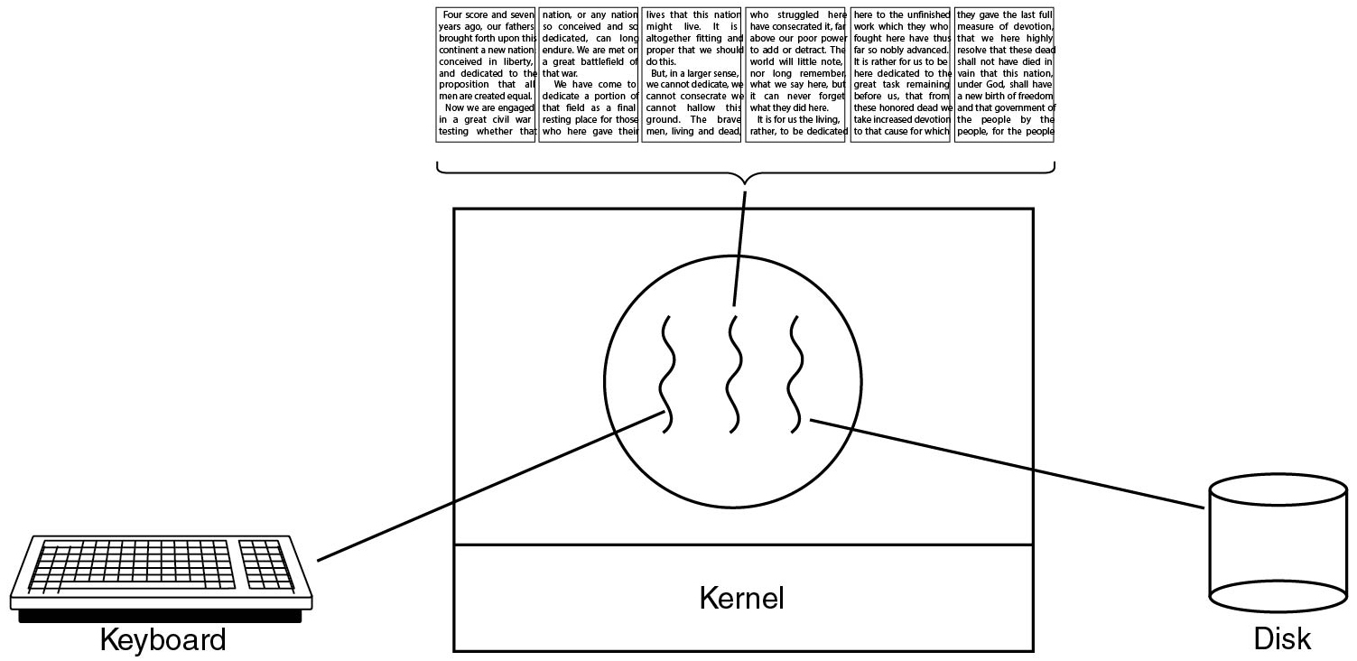
Thread Usage (1)
Figure 2.7 A word processor with three threads.
Notes:
Long Description:
The image consists of a square block in the center with two horizontal partitions. A circle with three wavy lines is in the first partition and the second partition is labeled kernel. There is a keyboard on the left connected with the first wavy line in the circle and a cylindrical disk on the right connected with the third wavy line of a circle. Six pages of a book are shown on the top of the square and are connected with the center wavy line of a circle. The pages of the book are about a nation's liberty, dedication, devotion, and freedom and the idea government of the people, by the people, and for the people.

Slide 27
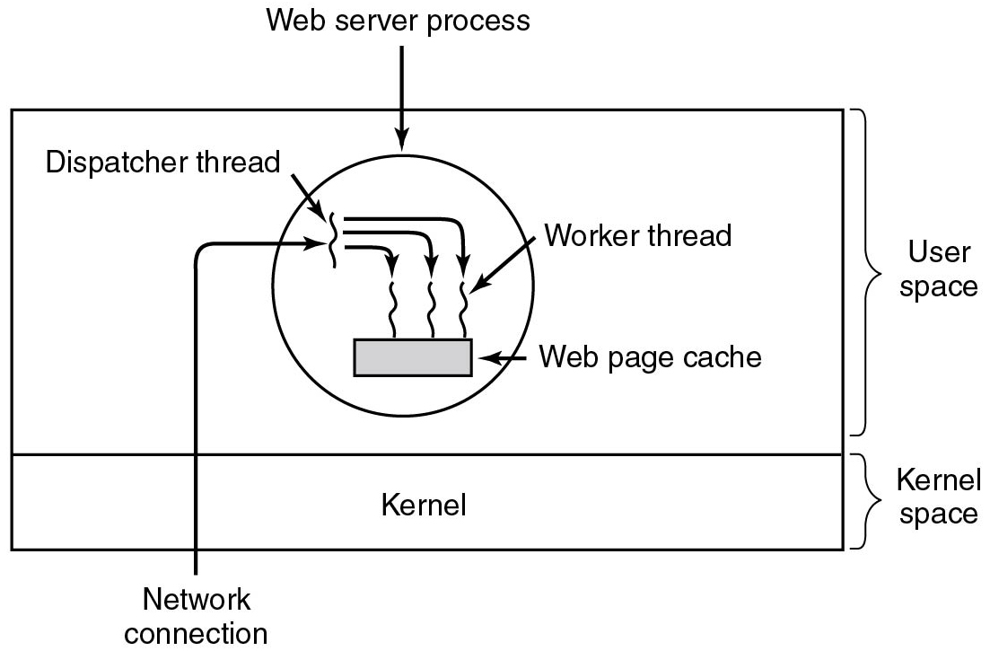
Thread Usage (2)
Figure 2.8 A multithreaded Web server.
Notes:
Long Description:
There is a rectangular block with two horizontal partitions. The first partition has a circle labeled Web server process with three wavy lines placed on a small rectangular block labeled Web page cache. There is a fourth wavy line in the upper left region of the circle labeled Dispatcher thread and an outside Network connection also points to it with a forward arrow. There are three downward arrows from this fourth wavy line that points to three wavy lines in a circle. The third wavy line in a circle is labeled worker thread. The second partition is labeled Kernel. The first partition is categorized as User-space and the second partition is categorized as Kernel space.

Slide 28
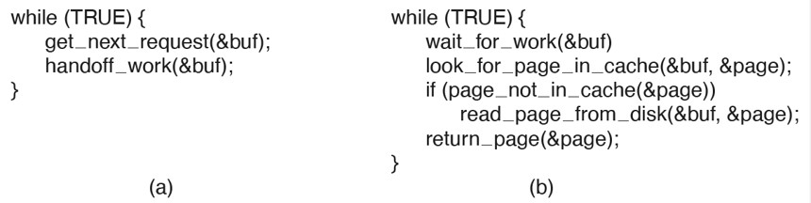
Thread Usage (3)
Figure 2.9 A rough outline of the code for Figure 2.8. (a) Dispatcher thread. (b) Worker thread.
Notes:
Long Description:
The 4 line of code for figure a are as follows.
while open parenthesis TRUE close parenthesis open curly bracket
get under score next under score request open parenthesis ampersand buf close parenthesis semi colon
handoff under score work open parenthesis ampersand buf close parenthesis semi colon
close curly bracket
The 7 lines of code for figure open parenthesis b close parenthesis are as follow
while open parenthesis TRUE close parenthesis open curly bracket
wait under score for under score work open parenthesis &buf close parenthesis
look under score for under score page under score in under score cache open parenthesis ampersand buf coma ampersand page close parenthesis semi colon
if open parenthesis page under score not under score in under score cache open parenthesis ampersand page close parenthesis close parenthesis
read under score page under score from under score disk open parenthesis ampersand buf coma ampersand page close parenthesis semi colon
return under score page open parenthesis ampersand page close parenthesis semi colon
close curly bracket

Slide 29
Threads, Process, Finite State Machine
Model | Characteristics
Threads | Parallelism, blocking system calls
Single-threaded process | No parallelism, blocking system calls
Finite-state machine | Parallelism, nonblocking system calls, interrupts

Slide 30
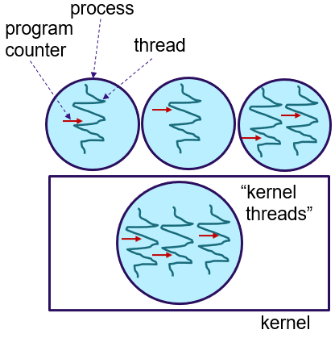
Threads and Processes
Threads reside in the same address space of a single process
All information exchange is via data shared between the threads
Threads synchronize via simple primitives
Each thread has its own stack, hardware registers, and state
Thread table/switch: a lighter process table/switch
Each thread may call any O S-supported system call on behalf of the process to which it belongs
Notes:
Long Description:
The block is labeled as a kernel and the circle inside is labeled the kernel threads. Each circle has lines inside them. The circle on top is labeled process, the lines inside are labeled the thread, and the arrows pointing to the thread are labeled program counter.

Slide 31
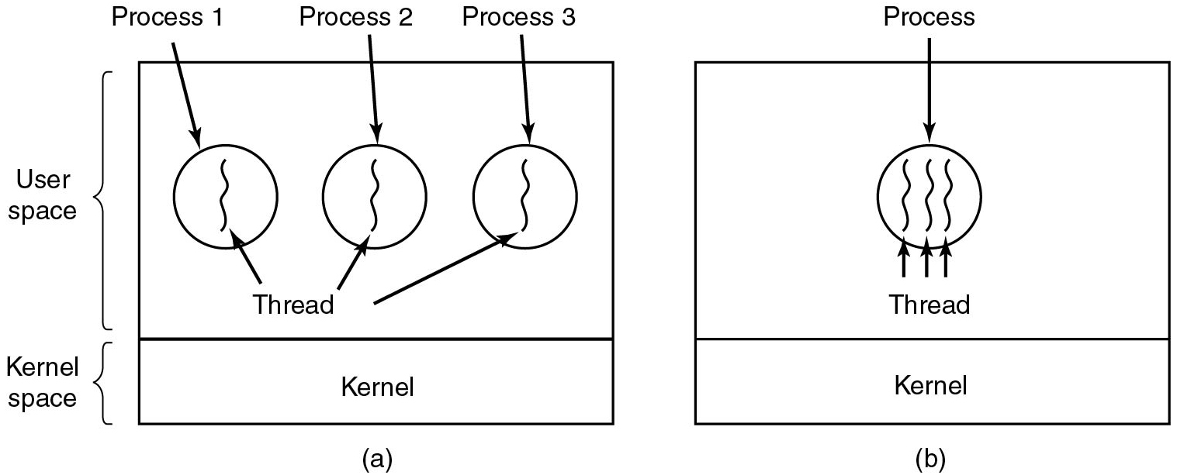
The Classical Thread Model (1)
Figure 2.10 (a) Three processes each with one thread. (b) One process with three threads.
Notes:
Long Description:
Part (a): There is a rectangular block with two horizontal partitions. The top first partition has three circles labeled Process 1, Process 2, and Process 3 with one wavy line in each circle labeled Thread. The second partition is labeled Kernel. The first partition is categorized as User-space and the second partition is categorized as kernel space. Part (b): There is a rectangular block with two horizontal partitions. The top first partition has a circle labeled Process with three wavy lines, each labeled Thread. The second partition is labeled Kernel.

Slide 32
The Classical Thread Model (2)
Per process items | Per thread items
Address space Global variables Open files Child processes Pending alarms Signals and signal handlers Accounting information | Program counter Registers Stack State
Figure 2.11 The first column lists some items shared by all threads in a process. The second one lists some items private to each thread.

Slide 33
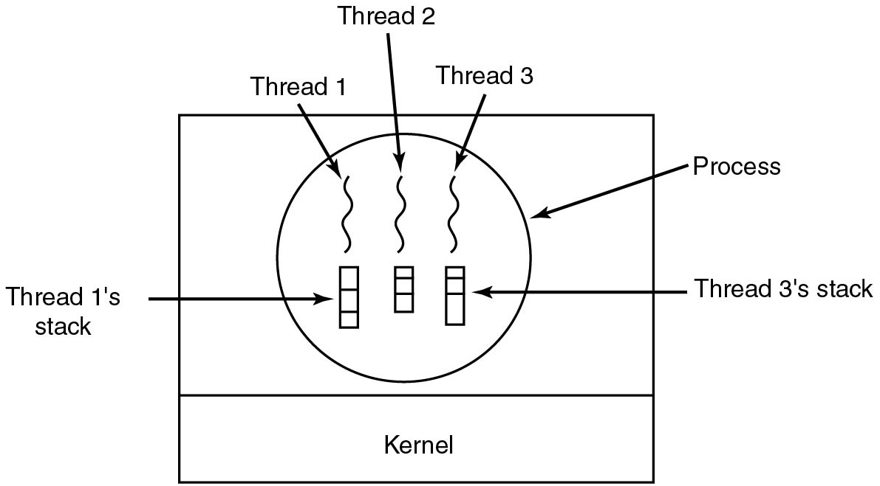
The Classical Thread Model (3)
Figure 2.12 Each thread has its own stack.
Notes:
Long Description:
There is a rectangular block with two horizontal partitions. The top first partition has a circle labeled Process with three wavy lines labeled Thread 1, Thread 2, and Thread 3, inside the circle. There are three vertical rectangular blocks with three horizontal partitions. The first vertical rectangular block labeled Thread 1's stack and the third labeled Thread 3's stack. The second partition is labeled Kernel.

Slide 34
P O S I X Threads (1 of 2)
Thread call | Description
P thread_create | Create a new thread
p thread_exit | Terminate the calling thread
p thread_join | Wait for a specific thread to exit
p thread_yield | Release the C P U to let another thread run
p thread_attr_init | Create and initialize a thread's attribute structure
p thread_attr_destroy | Remove a thread's attribute structure
Figure 2.13 Some of the P threads function calls.

Slide 35
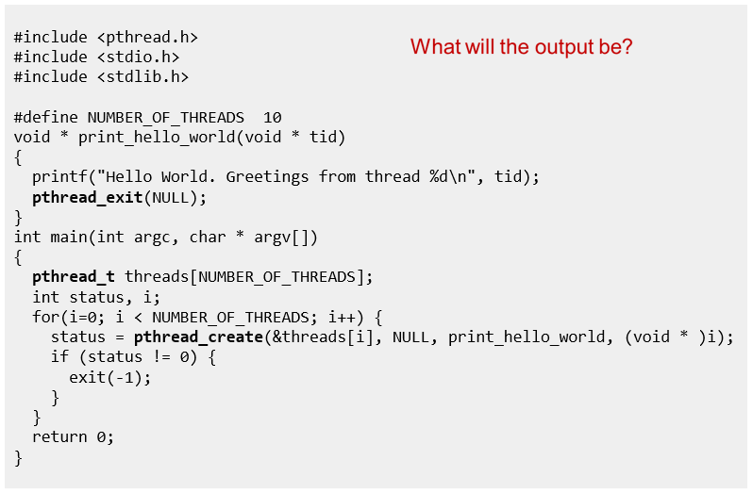
P threads
Notes:
A: 10x “Hello World. Greetings from thread …” in arbitrary order
Long Description:
The code from top to bottom is as follows.
hashtag include left angle bracket p thread dot h right angle bracket
hashtag include left angle bracket stdio dot h right angle bracket
hashtag include left angle bracket stdlib dot h right angle bracket
hashtag define NUMBER underscore OF underscore THREADS 10
void asterisk print underscore hello underscore world left parenthesis void asterisk t i d right parenthesis
left brace
print f left parenthesis double quote Hello World. Greetings from thread percent d backward slash n double quote comma t i d right parenthesis semi colon
p thread underscore exit left parenthesis NULL right parenthesis semi colon
right brace
int main left parenthesis int arg c comma char asterisk arg v left bracket right bracket right parenthesis
left brace
p thread underscore t threads left bracket NUMBER underscore OF underscore THREADS right bracket semi colon
int status comma i semi colon
for left parenthesis i equal 0 semicolon i left angle bracket NUMBER underscore OF underscore THREADS semicolon i plus plus right parenthesis left brace
status equal p thread underscore create left parenthesis and thread left bracket i right bracket comma NULL comma print underscore hello underscore world comma left parenthesis void asterisk right parenthesis i right parenthesis semi colon
if left parenthesis status exclamation mark equals 0 right parenthesis left brace
exit left parenthesis negative 1 right parenthesis semi colon
right brace
right brace
return 0 semicolon
right brace
What will the output be?

Slide 36
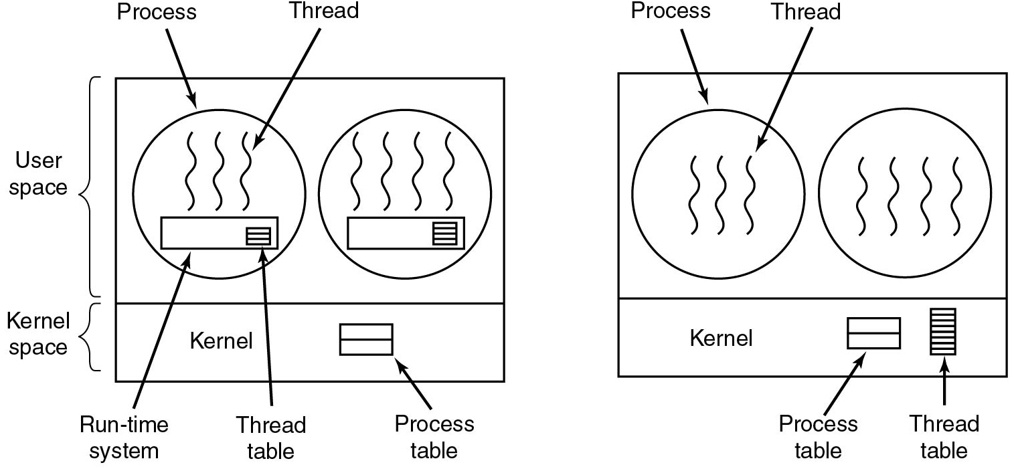
Implementing Threads in User Space
Figure 2.15 (a) A user-level threads package. (b) A threads package managed by the kernel.
Notes:
Long Description:
The image consists of two parts. Part 1: There is a rectangular block with two horizontal partitions. The first partition is categorized as User-space and the second is kernel space. The top first partition has two circles. The first circle labeled Process has three vertical wavy lines labeled Thread. There is a rectangular block labeled Run time system with another small block labeled Thread table with three partitions. The second circle is the same as the first one, except that there is an extra wavy line in the circle. The second partition is labeled Kernel and a block with two horizontal partitions labeled Process table. Part 2: It is the same as part 1 except that there are no rectangular blocks in both circles. A rectangular block labeled thread table has many partitions is at the lower right end of the kernel space.

Slide 37
User Threads: Pros and Cons
+ Thread switching time (no mode switch)
+ Scalability, customizability (no in-kernel management)
- Transparency (typically requires app cooperation)
- Parallelism (blocking syscalls are problematic)
Notes:
Long Description:
The image consists of two parts. Part 1: There is a rectangular block with two horizontal partitions. The first partition is categorized as User-space and the second is kernel space. The top first partition has two circles. The first circle labeled Process has three vertical wavy lines labeled Thread. There is a rectangular block labeled Run time system with another small block labeled Thread table with three partitions. The second circle is the same as the first one, except that there is an extra wavy line in the circle. The second partition is labeled Kernel and a block with two horizontal partitions labeled Process table. Part 2: It is the same as part 1 except that there are no rectangular blocks in both circles. A rectangular block labeled thread table has many partitions is at the lower right end of the kernel space.

Slide 38
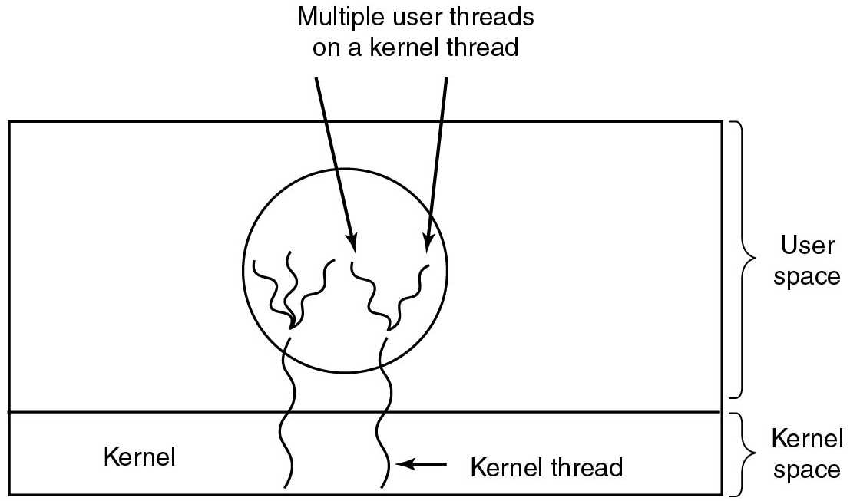
Hybrid Implementations
Figure 2.16 Multiplexing user-level threads onto kernel-level threads.
Notes:
Long Description:
A rectangular block has two horizontal partitions. The top first partition has a circle with multiple vertical wavy lines labeled Multiple user threads on a kernel thread. The second partition is labeled Kernel and two vertical wavy lines labeled kernel thread from the circle in the first partition enter the second partition. The first partition is categorized as User-space and the second partition is categorized as kernel space.

Slide 39
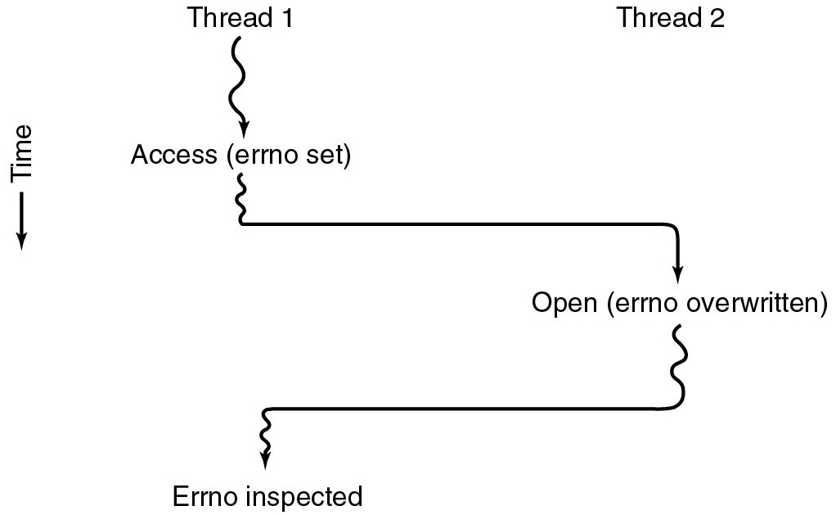
Making Single-Threaded Code Multithreaded (1)
Figure 2.17 Conflicts between threads over the use of a global variable.
Notes:
Long Description:
There are two vertical wavy lines labeled Thread 1 and thread 2. The vertical direction depicts time. Thread 1 is split into two parts and one of the parts is labeled Access (Errno set). Thread 1 then travels toward the right for a while, bends down with a downward arrow labeled Open (Errno overwritten). Then thread 2 travels toward the left for a while, bends down with a downward wavy arrow labeled Errno Inspected.

Slide 40
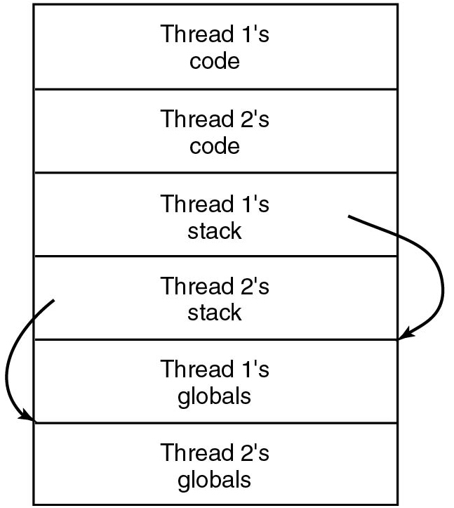
Making Single-Threaded Code Multithreaded (2)
Figure 2.18 Threads can have private global variables.
Notes:
Long Description:
A rectangular block has six partitions from top to bottom labeled Thread 1's code, Thread 2's code, Thread 1's stack, Thread 2's stack, Thread 1's globals, and Thread 2's globals. A circular arrow from Thread 1's stack points to Thread 1's globals. Another circular arrow from Thread 2's stack points to Thread 2's globals.

Slide 41
Threads: Issues
Does the O S keep track of threads?
  Kernel threads versus. user threads
What to do on fork?
  Clone all threads versus. calling thread
  What if a thread is currently blocking on a systems call?
What to do with signals?
  Send signal to all threads versus. single thread
  Per-process or per-thread signal handlers
Where to store per-thread variables?
Does sharing come at a cost?
Are threads required inside an operating system?
Notes:
Pthreads on Linux: The child process is created with a single thread—the one that called fork(). Thus: only the calling thread is replicated, not other threads. On other operating systems (e.g. Solaris) you can choose what fork does depending on what library you link to)
The entire virtual address space of the parent is replicated in the child, including the states of mutexes, condition variables, and other pthreads objects; the use of
Signals: Signals are sent to a process, handled by one of the threads
Per-thread variables: T L S (Thread Local Storage)
pthread_atfork(3) may be helpful for dealing with problems that this can cause.

Slide 42
Event-Driven Servers
Implement server as finite-state machine that responds to events using asynchronous system calls
  E.g., the availability of data on a socket
Implementation can be very efficient
Every event leads to a burst of activity without blocking
Most O S offer event notification interfaces for asynchronous I/O
  Linus: epoll
  FreeB S D: kqueue

Slide 43
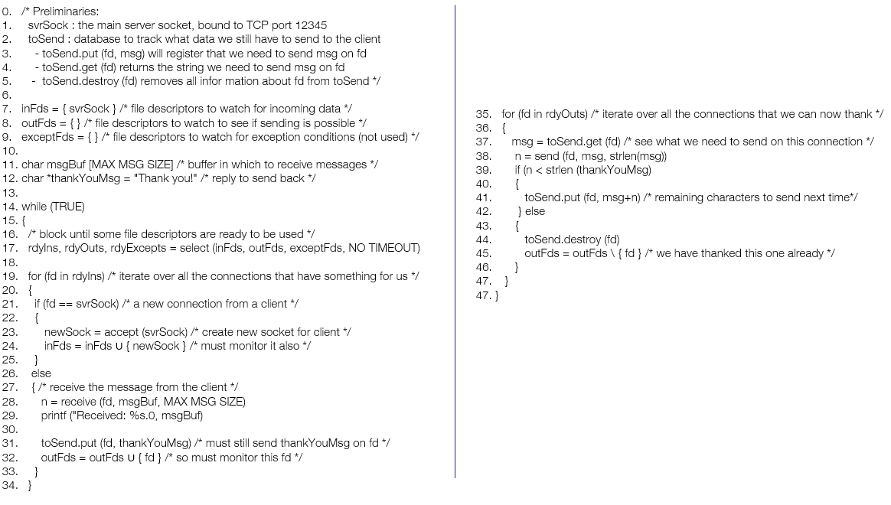
Event-Driven Server
Notes:
Long Description:
The code from top to bottom is as follows.
0. forward slash asterisk Preliminaries colon
1. svr Sock colon the main server socket comma bound to T C P port 12345
2. to Send colon database to track what data we still have to send to the client
3. dash to Send dot put right parenthesis f d comma msg right parenthesis will register that we need to send msg on f d
4. dash to Send dot get left parenthesis f d right parenthesis returns the string we need to send msg on f d
5. dash to Send dot destroy left parenthesis f d right parenthesis removes all information about f d from to Send asterisk forward slash
6.
7. in F d s equals to left brace svr S oc k right brace forward slash asterisk file descriptors to watch for incoming data asterisk forward slash
8. out F d s equals to left brace right brace forward slash asterisk file descriptors to watch to see if sending is possible asterisk forward slash
9. except F d s equals to left brace right brace forward slash asterisk file descriptors to watch for exception conditions left parenthesis not used right parenthesis asterisk forward slash
10.
11. char msg Buf left bracket MAX MSG SIZE right bracket forward slash asterisk buffer in which to receive messages asterisk forward slash
12. char asterisk thank You Msg equals to double quotation Thank you exclamation mark double quote forward slash asterisk reply to send back asterisk forward slash
13.
14. while left parenthesis TRUE right parenthesis
15. left brace
16. forward slash asterisk block until some file descriptors are ready to be used asterisk forward slash
17. Rdy Ins comma rdy Outs comma r d y Excepts equals select left parenthesis in Fds comma out Fds comma except Fds comma NO TIMEOUT right parenthesis
18.
19. for left parenthesis f d in rdy lns right parenthesis forward slash asterisk iterate over all the connections that have something for us asterisk forward slash
20. left brace
21. if left parenthesis f d equals equals svr sock right parenthesis forward slash asterisk a new connection from a client asterisk forward slash
22. left brace
23. New Sock equals to accept left parenthesis svr sock right parenthesis forward slash asterisk create new socket for client asterisk forward slash
24. In Fds equals to in Fds left brace new Sock right brace forward slash asterisk must monitor it also asterisk forward slash
25. right brace
26. else
27. left brace forward slash asterisk receive the message from the client asterisk forward slash
28. n equals receive left parenthesis f d comma msg B u f comma MAX MSG SIZE right parenthesis
29. Print f left parenthesis double quotation Received colon percent s dot 0 comma msg B u f right parenthesis
30.
31. to send dot put left parenthesis f d comma thank you msg right parenthesis forward slash asterisk must still send thank you msg on f d asterisk forward slash
32. out F d s equals to out F d s left brace f d right brace forward slash asterisk so must monitor this f d asterisk forward slash
33. right brace
34. right brace
35. for left parenthesis f d in r d y out s right parenthesis forward slash asterisk iterate over all the connections that we can now thank asterisk forward slash
36. left brace
37. msg equals left parenthesis f d right parenthesis forward slash asterisk see what we need to send on this connection asterisk forward slash
38. n equals to send left parenthesis f d comma msg comma strlen left parenthesis msg right parenthesis right parenthesis
39. if left parenthesis n right angle bracket strlen left parenthesis thank right parenthesis
40. left brace
41. to send dot put left parenthesis f d comma msg plus n right parenthesis forward slash asterisk remaining characters to send next time asterisk forward slash
42. right brace else
43. left brace
44. to send dot destroy left parenthesis f d right parenthesis
45. out F d s equals to out F d s backward slash left brace f d right brace forward slash asterisk we have thanked this one already asterisk forward slash
46. right brace
47. right brace
47. right brace

Slide 44
Single-Threaded VersuS Multi-threaded VersuS Event-Driven Servers
Model | Characteristics
Threads | Parallelism, blocking system calls
Single-threaded process | No parallelism, blocking system calls
Finite-state machine | Parallelism, nonblocking system calls, interrupts
Figure 2.20 Three ways to construct a server.

Slide 45
Synchronization and Inter-Process Communication (I P C)
Why?
Processes need some way to communicate:
  To share data throughout the execution
No explicit cross-process sharing:
  Data must be normally exchanged between processes
Processes need some way to synchronize:
  To account for dependencies
  To avoid they get in each other’s way
  Also applies to multithreaded execution

Slide 46
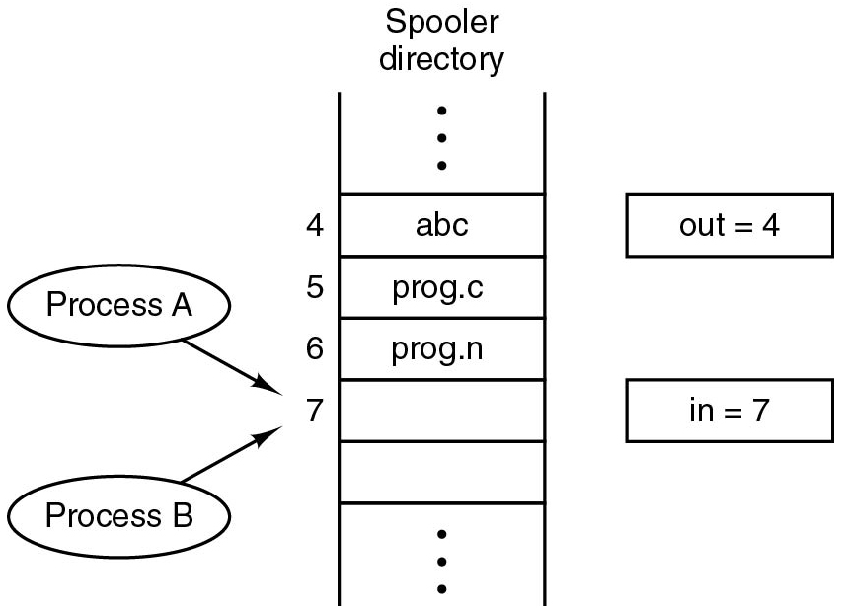
Race Conditions
Process A reads in=7 and decides to append its file at that position
A is suspended by O S (because its slott expired)
Process B also reads in=7 and puts its file at that position
B sets in=8 and eventually gets suspended.
A writes its file to position 7
Problem: reading/updating in should be an atomic action. If it is not, processes can race each other and come to wrong conclusions
Notes:
Long Description:
There are two vertical lines with multiple partitions labeled Spooler directory. Some partitions are labeled 4, 5, 6, and 7 from top to bottom. There are two oval-shaped blocks on the left labeled Process A and Process B with forwarding arrows pointing to the seventh partition. There are two rectangular blocks on the right labeled out equals 4 and in equals 7, respectively, from top to bottom.

Slide 47
Critical Regions (1)
Requirements to avoid race conditions:
  No two processes may be simultaneously inside their critical regions.
  No assumptions may be made about speeds or the number of C P U s.
  No process running outside its critical region may block other processes.
  No process should have to wait forever to enter its critical region.

Slide 48
Critical Regions (2)
Critical region: a code region with access to shared resources
  No two processes may be simultaneously in their critical regions
  No assumptions may be made about speeds or nr. of C P U s
  No process running outside its critical region may block others
  No process should have to wait forever to enter its critical region
(Non)solutions:
  Disable interrupts: simply prevent that the C P U can be reallocated. Works for single-C P U systems only
  Lock variables: guard critical regions with 0/1 variables. Races now occur on the lock variables themselves

Slide 49
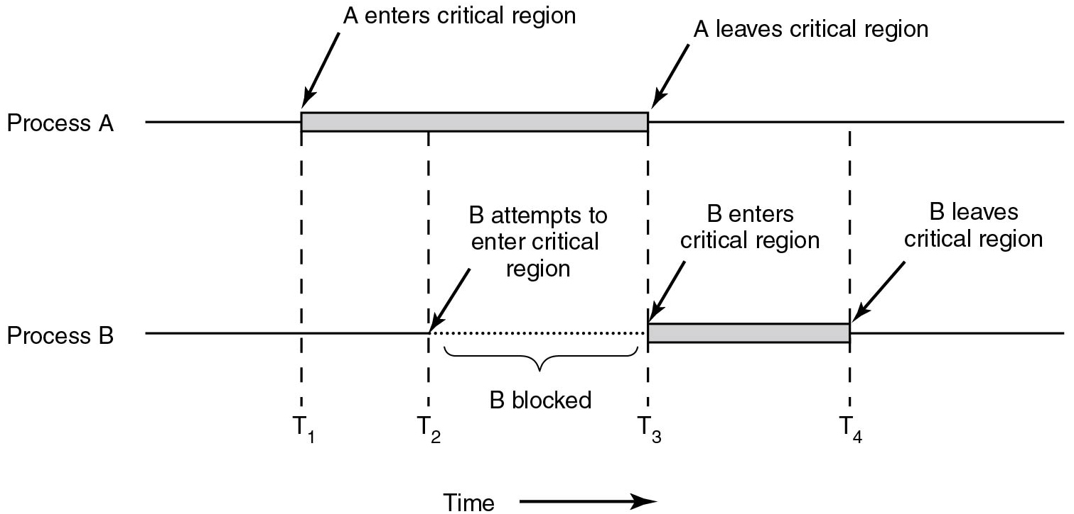
Critical Regions (3)
Figure 2.22 Mutual exclusion using critical regions.
Notes:
Long Description:
The horizontal direction represents time. The image consists of two parts labeled Process "A" and Process B. A straight horizontal line labeled Process "A" has a horizontal rectangular block placed on it nearly at the center. An arrow "A" enters the critical region points to the left end of the block. Another arrow labeled "A" leaves the critical region points to the right end of the block. A straight horizontal line labeled Process B has a horizontal rectangular block placed on it exactly at the point where the rectangular block of Process "A" ends. An arrow labeled B enters the critical region points to the left end of the block. Another arrow labeled B leaves the critical region points to the right end of the block. There are four time intervals labeled T1, T2, T3, and T4 from left to right. The T1 time cycle is marked from where A enters the critical region, enters process B, and exits. The T2 time cycle is marked from where the Process "A" block, attempts to enter process B, and exits. The T3 time cycle is marked from where "A" leaves the critical region, enters process B. The T4 time cycle is marked from process A end of the line enters B where B leaves the critical region. The area between T2 and T3 is labeled B attempts to enter the critical region, line of Process B at this point is a dotted line and marked as B blocked.

Slide 50
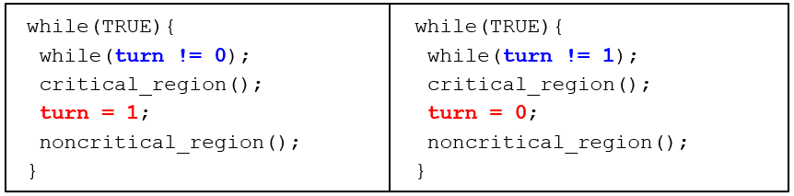
Mutual Exclusion with Busy Waiting: Strict Alternation
Unfortunately, this is yet another (non)solution:
  Does not permit processes to enter their critical regions two times in a row
  A process outside the critical region can effectively block another one
Notes:
Long Description:
The code for the first set on the left from top to bottom is as follows.
while left parenthesis TRUE right parenthesis left brace
while left parenthesis turn exclamation mark equals to 0 right parenthesis semicolon
critical underscore region left parenthesis right parenthesis semicolon
turn equals to 1 semi-colon
noncritical underscore region left parenthesis right parenthesis semicolon
right brace
The code for the second set on the right from top to bottom is as follows.
while left parenthesis TRUE right parenthesis left brace
while left parenthesis turn exclamation mark equals to 1 semicolon
critical underscore region left parenthesis right parenthesis semicolon
turn equals to 0 semicolon
noncritical underscore region left parenthesis right parenthesis semicolon
right brace

Slide 51
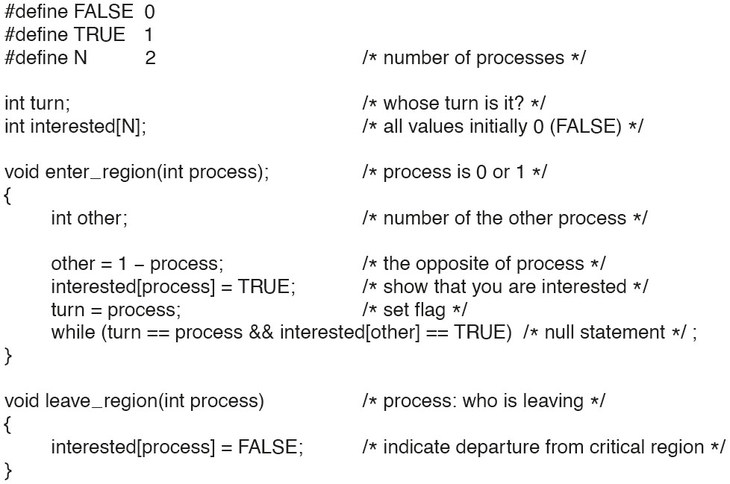
Mutual Exclusion with Busy Waiting:
Peterson’s Solution
Figure 2.24. Peterson’s solution for achieving mutual exclusion.
Notes:
Long Description:
hash define FALSE 0
hash define TRUE 1
hash define N 2 forward slash asterisk number of processes asterisk forward slash
int turn semicolon forward slash asterisk whose turn is it question mark asterisk forward slash
int interested open box bracket N close box bracket semicolon forward slash asterisk all values initially 0 open parenthesis FALSE close parenthesis asterisk forward slash
void enter underscore region open parenthesis int process close parenthesis semicolon forward slash asterisk process is 0 or 1 asterisk forward slash
open curly bracket
int other semicolon forward slash asterisk number of the other process asterisk forward slash
other equals 1 minus process semicolon forward slash asterisk the opposite of process asterisk forward slash
interested open box bracket process close box bracket equals TRUE semicolon forward slash asterisk show that you are interested asterisk forward slash
turn equals process semicolon forward slash asterisk set flag asterisk forward slash
while open parenthesis turn equals equals process ampersand ampersand interested open box bracket other close box bracket equals equals TRUE close parenthesis forward slash asterisk null statement asterisk forward slash semicolon
close curly bracket
void leave underscore region open parenthesis int process close parenthesis forward slash asterisk process colon who is leaving asterisk forward slash
open curly bracket
interested open box bracket process close box bracket equals FALSE semicolon forward slash asterisk indicate departure from critical region asterisk close parenthesis
close curly bracket

Slide 52
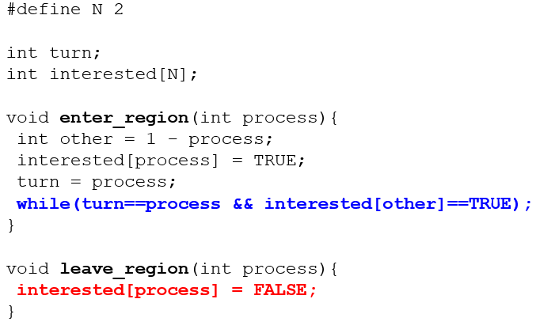
Mutual Exclusion with Busy Waiting: Peterson’s algorithm
Notes:
Long Description:
The code from top to bottom reads as follows.
hash define N 2
int turn semicolon
int interested left bracket N right bracket semicolon
void enter underscore region left parenthesis int process right parenthesis left brace
int other equals 1 minus process semicolon
interested left bracket process right bracket equals TRUE semicolon
turn equals process semicolon
while left parenthesis turn equals equals process ampersand ampersand interested left bracket other right bracket equals equals TRUE right parenthesis
right brace
void leave underscore region left parenthesis int process right parenthesis left brace
interested left bracket process right bracket equals FALSE semicolon
right brace

Slide 53
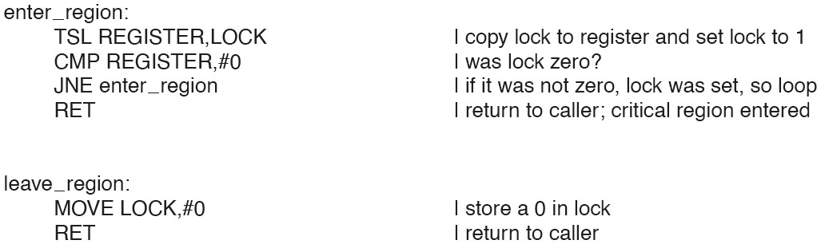
Mutual Exclusion with Busy Waiting: The T S L Instruction (1 of 2)
Figure 2.25. Entering and leaving a critical region using the T S L instruction.
Notes:
Long Description:
enter underscore region colon
TSL REGISTER coma LOCK vertical line copy lock to register and set lock to 1
CMP REGISTER coma hash 0 vertical line was lock zero question mark
JNE enter underscore region vertical line if it was not zero coma lock was set coma so loop
RET vertical line return to caller semicolon critical region entered
leave underscore region colon
MOVE LOCK coma hash 0 vertical line store a 0 in lock
RET vertical line return to caller

Slide 54
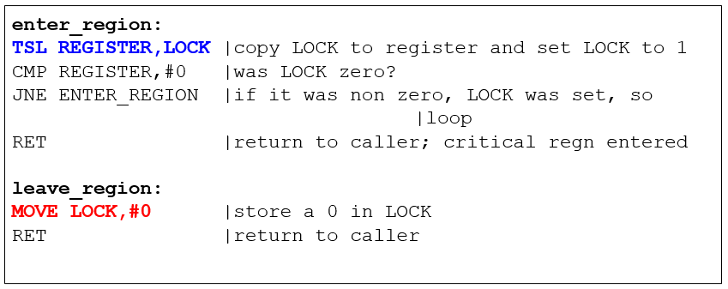
Mutual Exclusion with Busy Waiting: The T S L Instruction (2 of 2)
Hardware-assisted solution to the mutual exclusion problem
Atomic test and set of a memory value
Spin until LOCK is acquired
Notes:
Long Description:
The instruction from top to bottom are as follows.
enter underscore region colon
T S L REGISTER comma LOCK vertical bar copy lock to register and set lock to 1
C M P REGISTER comma hashtag 0 vertical bar was lock zero question mark
J N E enter underscore region vertical bar if it was non zero comma lock was set comma so vertical bar loop
R E T vertical bar return to caller semicolon critical r e g n entered
leave underscore region colon
MOVE LOCK comma hashtag 0 vertical bar store a 0 in lock
R E T vertical bar return to caller

Slide 55
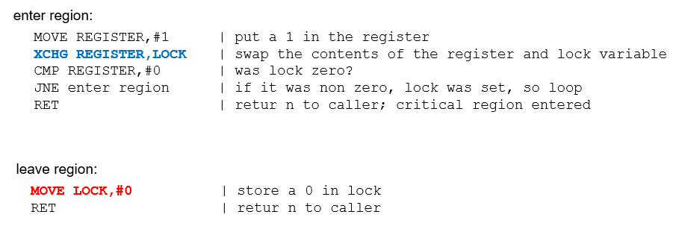
Mutual Exclusion with Busy Waiting: The X C H G Instruction
Figure 2.26 Entering and leaving a critical region using the X C H G instruction
Notes:
Long Description:
enter underscore region colon
MOVE REGISTER coma hash 1 vertical line put a 1 in the register
XCHG REGISTER coma LOCK vertical line swap the contents of the register and lock variable
CMP REGISTER coma hash 0 vertical line was lock zero question mark
JNE enter underscore region vertical line if it was non zero coma lock was set coma so loop
RET vertical line return to caller semicolon critical region entered
leave underscore region colon
MOVE LOCK coma hash 0 vertical line store a 0 in lock
RET vertical line return to caller

Slide 56
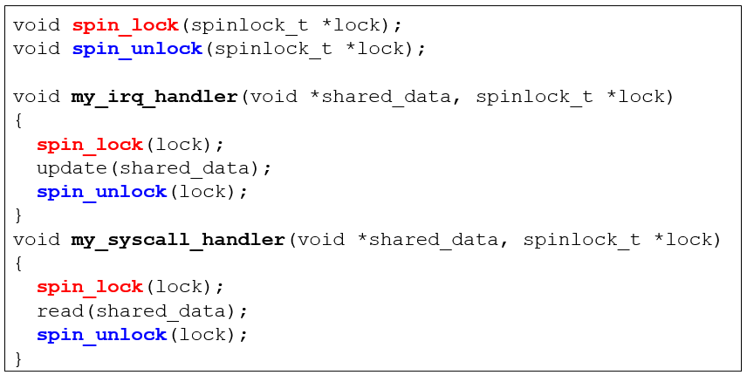
Spinlocks and Spinlock Problems
What would happen when we get an interrupt after the syscall handler has taken the lock?
Notes:
If irq is off when my_irq_handler is called, we have a deadlock
Long Description:
The code from top to bottom reads as follows.
void spin underscore lock left parenthesis spinlock, underscore, T asterisk lock left parenthesis, semicolon.
void spin underscore unlock left parenthesis spinlock, underscore, T asterisk lock left parenthesis, semicolon.
void my underscore I R Q under score handler, right parenthesis, void asterisk shared underscore data, comma spinlock, underscore T asterisk lock.
left brace
spin underscore lock left parenthesis lock right parenthesis semicolon
update left parenthesis shared underscore data right parenthesis semicolon
spin underscore unlock left parenthesis lock right parenthesis semicolon
right brace
void my underscore syscall underscore handler left parenthesis void asterisk shared underscore data comma spinlock underscore t asterisk lock
left brace
spin underscore lock left parenthesis lock right parenthesis semicolon
read left parenthesis shared underscore data right parenthesis semicolon
spin underscore unlock left parenthesis lock right parenthesis semicolon
right brace

Slide 57
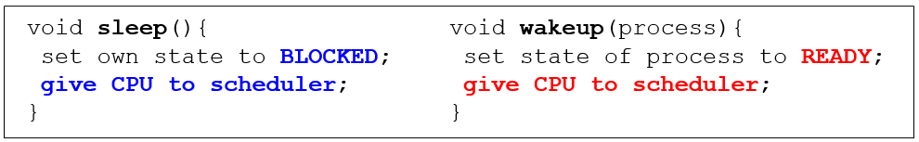
Avoiding Busy Waiting
The solutions so far let a process keep the C P U busy waiting until it can enter its critical region (spin lock)
Solution: let a process waiting to enter its critical region return the C P U to the scheduler voluntarily
Notes:
Long Description:
The code from top to bottom in the first set is as follows.
void sleep left parenthesis right parenthesis left brace
set own state to blocked semicolon
give C P U to scheduler
right brace
void wakeup left parenthesis process right parenthesis left brace
set state of process to ready semicolon
give C P U to scheduler
right brace

Slide 58
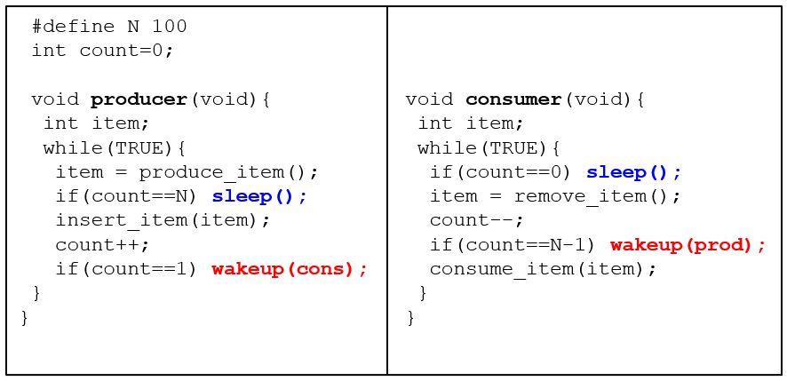
Producer-Consumer (1 of 4)
Notes:
Race condition. It can occur because access to count is unconstrained. As a consequence, the following situation could possibly occur. The buffer is empty and the consumer has just read count to see if it is 0. At that instant, the scheduler decides to stop running the consumer temporarily and start running the producer. The producer inserts an item in the buffer, increments count, and notices that it is now 1. Reasoning that count was just 0, and thus the consumer must be sleeping, the producer calls wakeup to wake the consumer up. Unfortunately, the consumer is not yet logically asleep, so the wakeup signal is lost. When the consumer next runs, it will test the value of count it previously read, find it to be 0, and go to sleep. Sooner or later the producer will fill up the buffer and also go to sleep. Both will sleep forever.
The essence of the problem here is that a wakeup sent to a process that is not (yet) sleeping is lost. If it were not lost, everything would work. A quick fix is to modify the rules to add a wakeup waiting bit to the picture. When a wakeup is sent to a process that is still awake, this bit is set. Later, when the process tries to go to sleep, if the wakeup waiting bit is on, it will be turned off, but the process will stay awake. The wakeup waiting bit is a piggy bank for storing wakeup signals.
The consumer clears the wakeup waiting bit in every iteration of the loop
Long Description:
The code from top to bottom is as follows.
hashtag define N 100
int count equals 0 semicolon
void producer left parenthesis void right parenthesis left brace
int item semicolon
while left parenthesis TRUE right parenthesis left
item equals produce underscore item left parenthesis right parenthesis semicolon
if left parenthesis count equals equals N right parenthesis sleep left parenthesis right parenthesis semicolon
insert underscore item left parenthesis item right parenthesis semicolon
count plus plus semicolon
if left parenthesis count equals equals 1 right parenthesis wakeup left parenthesis cons right parenthesis semicolon
right brace
right brace
void consumer left parenthesis void right parenthesis left brace
int item semicolon
while left parenthesis TRUE right parenthesis left brace
if left parenthesis count equals equals 0 right parenthesis sleep left parenthesis right parenthesis semicolon
item equals remove underscore item left parenthesis right parenthesis semicolon
count minus minus
if left parenthesis count equals equals N minus 1 right parenthesis wakeup left parenthesis p r o d right parenthesis semicolon
consume underscore item left parenthesis item right parenthesis semicolon
right brace
right brace

Slide 59
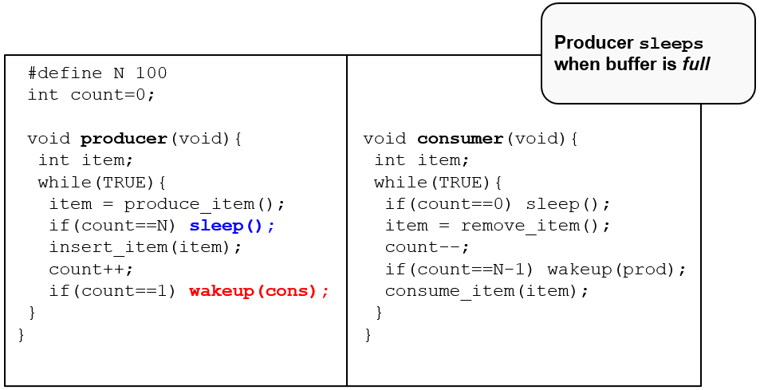
Producer-Consumer (2 of 4)
Notes:
Long Description:
The code from top to bottom is as follows.
hashtag define N 100
int count equals 0 semicolon
void producer left parenthesis void right parenthesis left brace
int item semicolon
while left parenthesis TRUE right parenthesis left
item equals produce underscore item left parenthesis right parenthesis semicolon
if left parenthesis count equals equals N right parenthesis sleep left parenthesis right parenthesis semicolon
insert underscore item left parenthesis item right parenthesis semicolon
count plus plus semicolon
if left parenthesis count equals equals 1 right parenthesis wakeup left parenthesis cons right parenthesis semicolon
right brace
right brace
void consumer left parenthesis void right parenthesis left brace
int item semicolon
while left parenthesis TRUE right parenthesis left brace
if left parenthesis count equals equals 0 right parenthesis sleep left parenthesis right parenthesis semicolon
item equals remove underscore item left parenthesis right parenthesis semicolon
count minus minus
if left parenthesis count equals equals N minus 1 right parenthesis wakeup left parenthesis p r o d right parenthesis semicolon
consume underscore item left parenthesis item right parenthesis semicolon
right brace
right brace
A insert below reads producer sleeps when buffer is full.

Slide 60
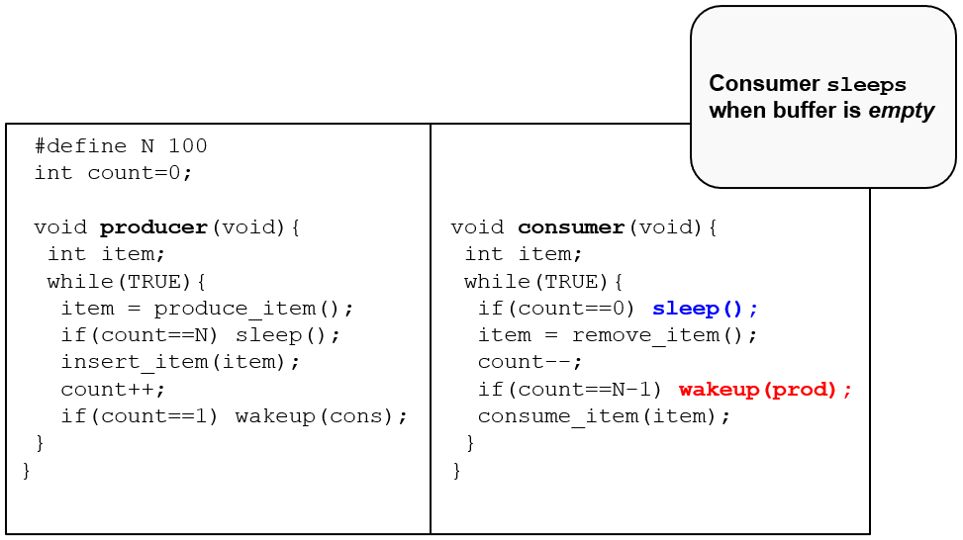
Producer-Consumer (3 of 4)
Notes:
Long Description:
The code from top to bottom is as follows.
hashtag define N 100
int count equals 0 semicolon
void producer left parenthesis void right parenthesis left brace
int item semicolon
while left parenthesis TRUE right parenthesis left
item equals produce underscore item left parenthesis right parenthesis semicolon
if left parenthesis count equals equals N right parenthesis sleep left parenthesis right parenthesis semicolon
insert underscore item left parenthesis item right parenthesis semicolon
count plus plus semicolon
if left parenthesis count equals equals 1 right parenthesis wakeup left parenthesis cons right parenthesis semicolon
right brace
right brace
void consumer left parenthesis void right parenthesis left brace
int item semicolon
while left parenthesis TRUE right parenthesis left brace
if left parenthesis count equals equals 0 right parenthesis sleep left parenthesis right parenthesis semicolon
item equals remove underscore item left parenthesis right parenthesis semicolon
count minus minus
if left parenthesis count equals equals N minus 1 right parenthesis wakeup left parenthesis p r o d right parenthesis semicolon
consume underscore item left parenthesis item right parenthesis semicolon
right brace
right brace
A insert below reads consumer sleeps when buffer is empty.

Slide 61
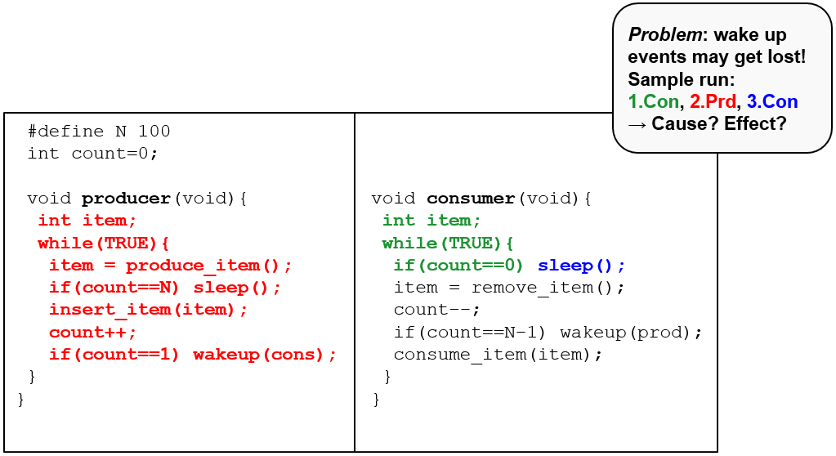
Producer-Consumer (4 of 4)
Notes:
Long Description:
The code from top to bottom is as follows.
hashtag define N 100
int count equals 0 semicolon
void producer left parenthesis void right parenthesis left brace
int item semicolon
while left parenthesis TRUE right parenthesis left
item equals produce underscore item left parenthesis right parenthesis semicolon
if left parenthesis count equals equals N right parenthesis sleep left parenthesis right parenthesis semicolon
insert underscore item left parenthesis item right parenthesis semicolon
count plus plus semicolon
if left parenthesis count equals equals 1 right parenthesis wakeup left parenthesis cons right parenthesis semicolon
right brace
right brace
void consumer left parenthesis void right parenthesis left brace
int item semicolon
while left parenthesis TRUE right parenthesis left brace
if left parenthesis count equals equals 0 right parenthesis sleep left parenthesis right parenthesis semicolon
item equals remove underscore item left parenthesis right parenthesis semicolon
count minus minus
if left parenthesis count equals equals N minus 1 right parenthesis wakeup left parenthesis p r o d right parenthesis semicolon
consume underscore item left parenthesis item right parenthesis semicolon
right brace
right brace
A insert below reads problem colon wake up events may get lost exclamation mark Sample run colon 1 dot con comma 2 dot P r d comma 3 dot C o n right arrow cause question mark effect question mark.

Slide 62
Semaphores
Idea: introduce a special sema integer type with 2 operations:
  down:
    If sema
    then block the calling process
    sema=sema-1 otherwise
  up:
    if there is a process blocking on sema, wake it up
    sema=sema+1 otherwise
O S guarantees all the operations are atomic by design
  Disable interrupts on single processors
  Spin locking on multiprocessors
Back to busy waiting problems?
Uses for binary semaphores (aka mutexes)?

Slide 63
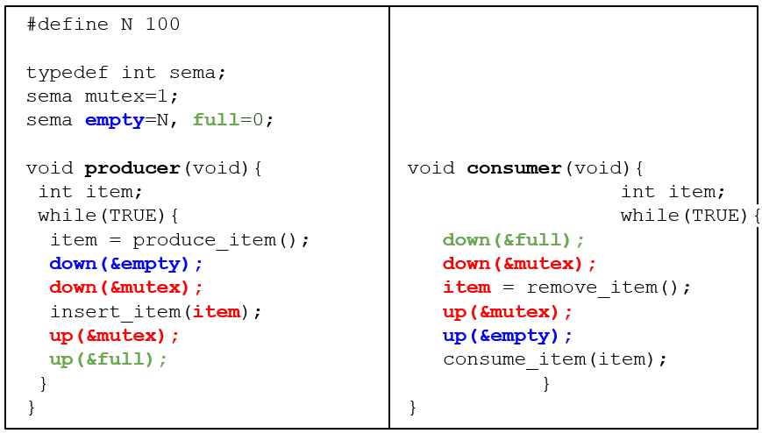
Semaphores: Producer-Consumer (1 of 5)
Notes:
different uses of semaphores:
mutex : for mutual exclusion
empty/full: for synchronization
Long Description:
The code from top to bottom is as follows.
hash define N 100
type def int s e m a
s e m a mutex equals 1 semicolon
s e m a empty equals N comma full equals 0 semicolon
void producer left parenthesis void right parenthesis left brace
int item semicolon
while left parenthesis TRUE right parenthesis left brace
item equals produce underscore item left parenthesis right parenthesis semicolon
down left parenthesis ampersand empty right parenthesis semicolon
down left parenthesis ampersand mutex right parenthesis semicolon
insert underscore item left parenthesis item right parenthesis semicolon
up left parenthesis ampersand mutex right parenthesis semicolon
up left parenthesis ampersand full right parenthesis semicolon
right brace
right brace
void consumer left parenthesis void right parenthesis left brace
int item semicolon
while left parenthesis TRUE right parenthesis left brace
down left parenthesis ampersand full right parenthesis semicolon
down left parenthesis ampersand mutex right parenthesis semicolon
item equals remove underscore item left parenthesis right parenthesis semicolon
up left parenthesis ampersand mutex right parenthesis semicolon
up left parenthesis ampersand empty right parenthesis semicolon
consume underscore item left parenthesis item
right brace
right brace

Slide 64
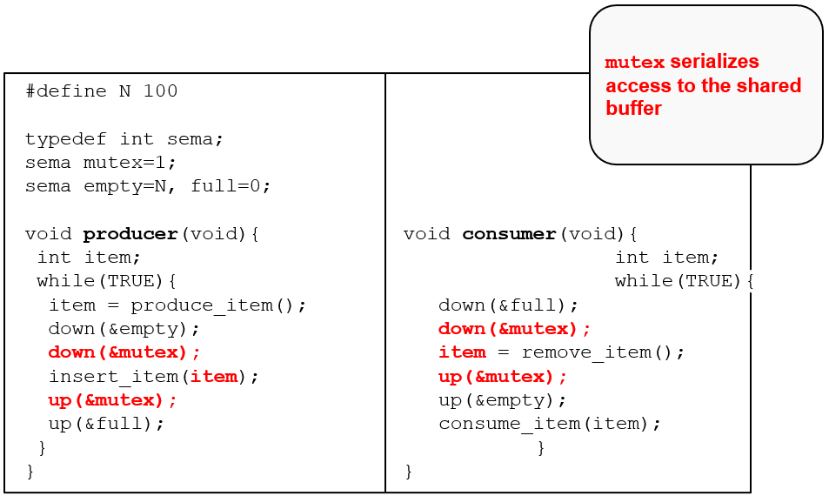
Semaphores: Producer-Consumer (2 of 5)
Notes:
Long Description:
The code from top to bottom is as follows.
hash define N 100
type def int s e m a
s e m a mutex equals 1 semicolon
s e m a empty equals N comma full equals 0 semicolon
void producer left parenthesis void right parenthesis left brace
int item semicolon
while left parenthesis TRUE right parenthesis left brace
item equals produce underscore item left parenthesis right parenthesis semicolon
down left parenthesis ampersand empty right parenthesis semicolon
down left parenthesis ampersand mutex right parenthesis semicolon
insert underscore item left parenthesis item right parenthesis semicolon
up left parenthesis ampersand mutex right parenthesis semicolon
up left parenthesis ampersand full right parenthesis semicolon
right brace
right brace
void consumer left parenthesis void right parenthesis left brace
int item semicolon
while left parenthesis TRUE right parenthesis left brace
down left parenthesis ampersand full right parenthesis semicolon
down left parenthesis ampersand mutex right parenthesis semicolon
item equals remove underscore item left parenthesis right parenthesis semicolon
up left parenthesis ampersand mutex right parenthesis semicolon
up left parenthesis ampersand empty right parenthesis semicolon
consume underscore item left parenthesis item
right brace
right brace
An insert on the top right reads mutex serializes access to the shared buffer.

Slide 65
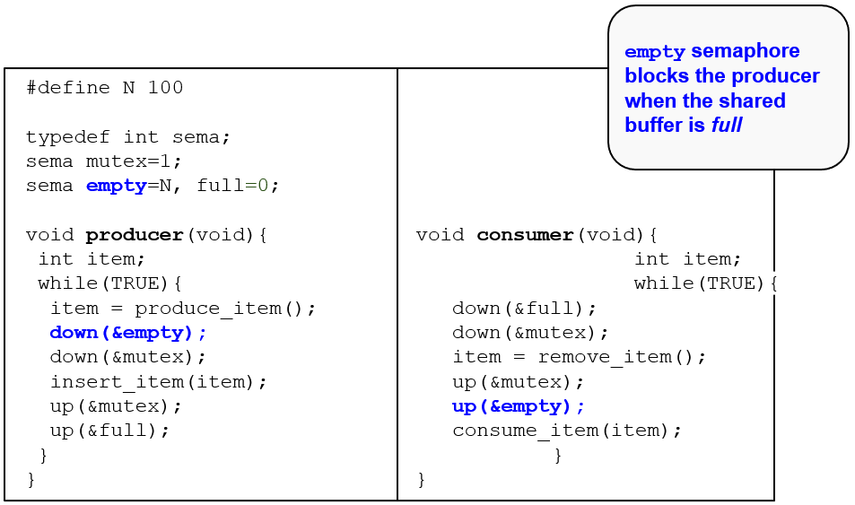
Semaphores: Producer-Consumer (3 of 5)
Notes:
Long Description:
The code from top to bottom is as follows.
hash define N 100
type def int s e m a
s e m a mutex equals 1 semicolon
s e m a empty equals N comma full equals 0 semicolon
void producer left parenthesis void right parenthesis left brace
int item semicolon
while left parenthesis TRUE right parenthesis left brace
item equals produce underscore item left parenthesis right parenthesis semicolon
down left parenthesis ampersand empty right parenthesis semicolon
down left parenthesis ampersand mutex right parenthesis semicolon
insert underscore item left parenthesis item right parenthesis semicolon
up left parenthesis ampersand mutex right parenthesis semicolon
up left parenthesis ampersand full right parenthesis semicolon
right brace
right brace
void consumer left parenthesis void right parenthesis left brace
int item semicolon
while left parenthesis TRUE right parenthesis left brace
down left parenthesis ampersand full right parenthesis semicolon
down left parenthesis ampersand mutex right parenthesis semicolon
item equals remove underscore item left parenthesis right parenthesis semicolon
up left parenthesis ampersand mutex right parenthesis semicolon
up left parenthesis ampersand empty right parenthesis semicolon
consume underscore item left parenthesis item
right brace
right brace
An insert on the top right reads empty semaphore blocks the producer when the shared buffer is full.

Slide 66
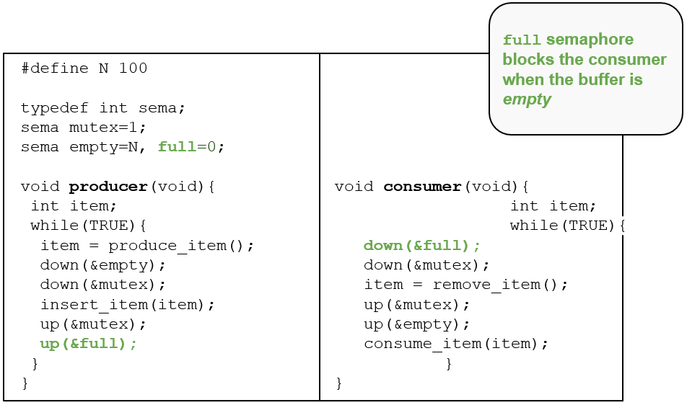
Semaphores: Producer-Consumer (4 of 5)
Notes:
Long Description:
The code from top to bottom is as follows.
hash define N 100
type def int s e m a
s e m a mutex equals 1 semicolon
s e m a empty equals N comma full equals 0 semicolon
void producer left parenthesis void right parenthesis left brace
int item semicolon
while left parenthesis TRUE right parenthesis left brace
item equals produce underscore item left parenthesis right parenthesis semicolon
down left parenthesis ampersand empty right parenthesis semicolon
down left parenthesis ampersand mutex right parenthesis semicolon
insert underscore item left parenthesis item right parenthesis semicolon
up left parenthesis ampersand mutex right parenthesis semicolon
up left parenthesis ampersand full right parenthesis semicolon
right brace
right brace
void consumer left parenthesis void right parenthesis left brace
int item semicolon
while left parenthesis TRUE right parenthesis left brace
down left parenthesis ampersand full right parenthesis semicolon
down left parenthesis ampersand mutex right parenthesis semicolon
item equals remove underscore item left parenthesis right parenthesis semicolon
up left parenthesis ampersand mutex right parenthesis semicolon
up left parenthesis ampersand empty right parenthesis semicolon
consume underscore item left parenthesis item
right brace
right brace
An insert on the top right reads full semaphore blocks the consumer when the buffer is empty.

Slide 67
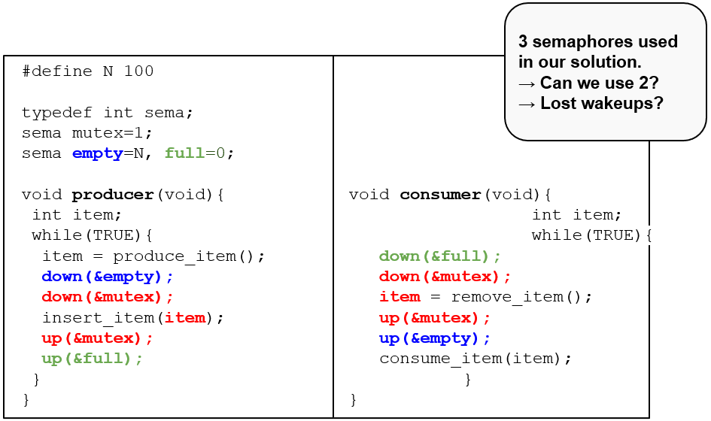
Semaphores: Producer-Consumer (5 of 5)
Notes:
Long Description:
The code from top to bottom is as follows.
hash define N 100
type def int s e m a
s e m a mutex equals 1 semicolon
s e m a empty equals N comma full equals 0 semicolon
void producer left parenthesis void right parenthesis left brace
int item semicolon
while left parenthesis TRUE right parenthesis left brace
item equals produce underscore item left parenthesis right parenthesis semicolon
down left parenthesis ampersand empty right parenthesis semicolon
down left parenthesis ampersand mutex right parenthesis semicolon
insert underscore item left parenthesis item right parenthesis semicolon
up left parenthesis ampersand mutex right parenthesis semicolon
up left parenthesis ampersand full right parenthesis semicolon
right brace
right brace
void consumer left parenthesis void right parenthesis left brace
int item semicolon
while left parenthesis TRUE right parenthesis left brace
down left parenthesis ampersand full right parenthesis semicolon
down left parenthesis ampersand mutex right parenthesis semicolon
item equals remove underscore item left parenthesis right parenthesis semicolon
up left parenthesis ampersand mutex right parenthesis semicolon
up left parenthesis ampersand empty right parenthesis semicolon
consume underscore item left parenthesis item
right brace
right brace
An insert on the top right reads 3 semaphores uses in our solution. Right arrow can we use 2 question mark. Right arrow lost wakeups question mark.

Slide 68
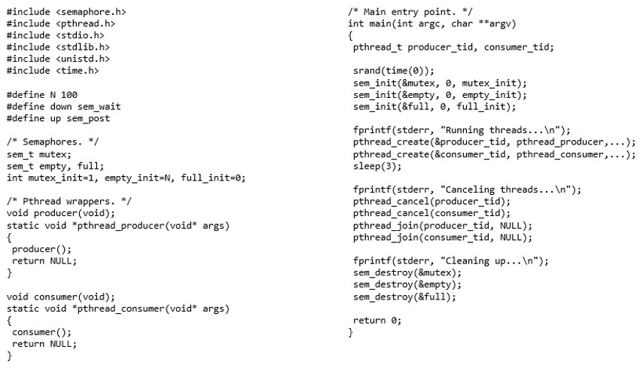
Full Example on Linux
Notes:
Long Description:
The code is as follows: hash include open angle bracket semaphore dot h close angle bracket; hash include open angle bracket pthread dot h close angle bracket; hash include open angle bracket s t d i o dot h close angle bracket; hash include open angle bracket s t d lib dot h close angle bracket; hash include open angle bracket uni s t d dot h close angle bracket; hash include open angle bracket time dot h close angle bracket; hash define N 100; hash define down sem underscore wait; hash define up sem underscore post; front slash asterisk Semaphores dot Asterisk front slash; sem underscore t mutex semicolon; sem underscore t empty, full semicolon; int mutex underscore init equals 1, empty underscore init equals N, full underscore init equals 0 semicolon; front slash asterisk Pthread wrappers dot Asterisk front slash; void producer open round bracket void close round bracket semicolon; static void asterisk pthread underscore producer open round bracket void asterisk args close round bracket; open curly bracket; producer open round bracket close round bracket semicolon; return NULL semicolon; close curly bracket; void consumer open round bracket void close round bracket semicolon; static void asterisk pthread underscore consumer open round bracket void asterisk args close round bracket; open curly bracket; consumer open round bracket close round bracket semicolon; return NULL semicolon; close curly bracket; forward slash asterisk Main entry point. Asterisk forward slash; int main open round bracket int arg c comma char asterisk asterisk arg v close round bracket; open curly bracket; pthread underscore t producer underscore tid comma consumer underscore tid semicolon; srand open round bracket time open round bracket 0 close round bracket close round bracket semicolon; sem underscore init open round bracket ampersand mutex comma 0 comma mutex underscore init close round bracket semicolon; sem underscore init open round bracket ampersand empty comma 0 comma empty underscore init close round bracket semicolon; sem underscore init open round bracket ampersand full comma 0 comma full underscore init close round bracket semicolon; f print f open round bracket stderr comma open quote Running threads ellipsis forward slash n close quote close round bracket semicolon; pthread underscore create open round bracket ampersand producer underscore tid comma pthread underscore producer comma ellipsis close round bracket semicolon; pthread underscore create open round bracket ampersand consumer underscore tid comma pthread underscore consumer comma ellipsis close round bracket semicolon; sleep open round bracket 3 close round bracket semicolon; f print f open round bracket stderr comma open quote Canceling threads ellipsis forward slash n close quote close round bracket semicolon; pthread underscore cancel open round bracket producer underscore tid close round bracket semicolon; pthread underscore cancel open round bracket consumer underscore tid close round bracket semicolon; pthread underscore join open round bracket producer underscore tid comma NULL close round bracket semicolon; pthread underscore join open round bracket consumer underscore tid comma NULL close round bracket semicolon; f print f open round bracket stderr comma close quote Cleaning up ellipsis forward slash n close quote close round bracket semicolon; sem underscore destroy open round bracket ampersand mutex close round bracket semicolon; sem underscore destroy open round bracket ampersand empty close round bracket semicolon; sem underscore destroy open round bracket ampersand full close round bracket semicolon; return 0 semicolon; close curly bracket.

Slide 69
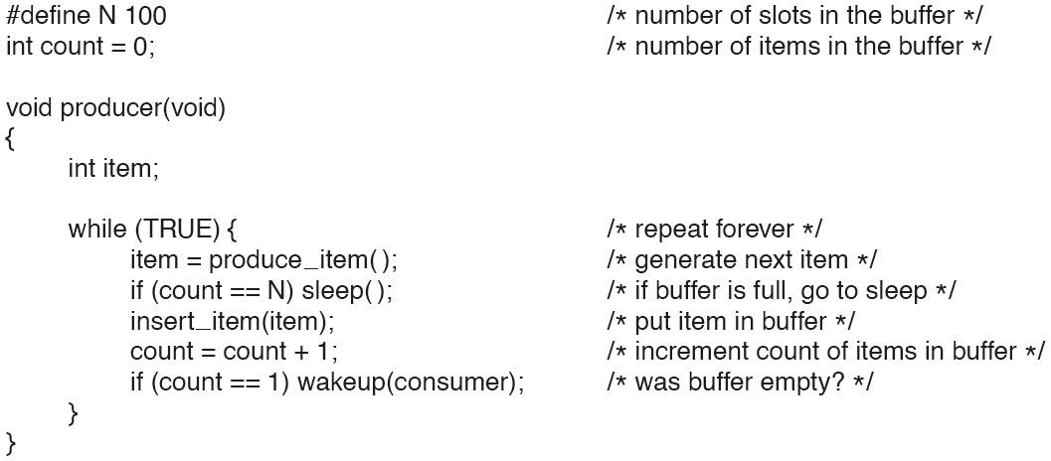
Semaphores (1)
Figure 2.28. The producer-consumer problem using semaphores.
Notes:
Long Description:
hashtag define N 100 forward slash asterisk number of slots in the buffer asterisk forward slash
type d e f int semaphore semicolon forward slash asterisk semaphores are a special kind of int asterisk forward slash
semaphore mutex equals 1 semicolon forward slash asterisk controls access to critical region asterisk forward slash
semaphore empty equals N semicolon forward slash asterisk counts empty buffer slots asterisk forward slash
semaphore full equals 0 semicolon forward slash asterisk counts full buffer slots asterisk forward slash
void producer left parenthesis void right parenthesis
left brace
int item semicolon
while left parenthesis TRUE right parenthesis left brace forward slash asterisk TRUE is the constant 1 asterisk forward slash
item equals produce underscore item left right parenthesis semicolon forward slash asterisk generate something to put in buffer asterisk forward slash
down left parenthesis ampersand empty right parenthesis semicolon forward slash asterisk decrement empty count asterisk forward slash
down left parenthesis ampersand mutex right parenthesis semicolon forward slash asterisk enter critical region asterisk forward slash
insert underscore item left parenthesis item right parenthesis semicolon forward slash asterisk put new item in buffer asterisk forward slash
up left parenthesis ampersand mutex right parenthesis semicolon forward slash asterisk leave critical region asterisk forward slash
up left parenthesis ampersand full right parenthesis semicolon forward slash asterisk increment count of full slots asterisk forward slash
right brace
right brace

Slide 70
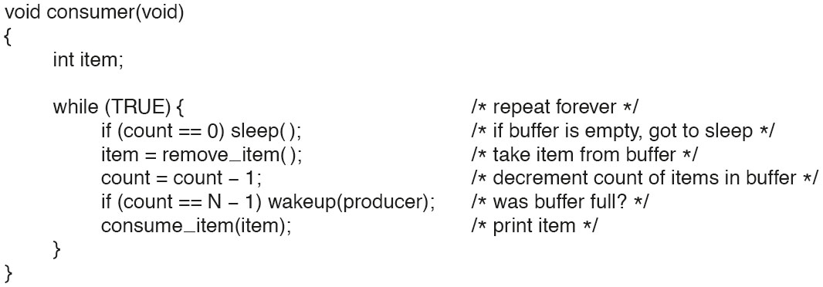
Semaphores (2)
Figure 2.28. The producer-consumer problem using semaphores.
Notes:
Long Description:
The code from top to bottom is as follows.
void consumer left parenthesis void right parenthesis
left brace
int item semicolon
while left parenthesis TRUE right parenthesis left brace forward slash asterisk infinite loop asterisk forward slash
down left parenthesis ampersand full right parenthesis semicolon forward slash asterisk decrement full count asterisk forward slash
down left parenthesis ampersand mutex right parenthesis semicolon forward slash asterisk enter critical region asterisk forward slash
item equals remove underscore item left parenthesis right parenthesis semicolon forward slash asterisk take item from buffer asterisk forward slash
up left parenthesis ampersand mutex right parenthesis semicolon forward slash asterisk leave critical region asterisk forward slash
up left parenthesis ampersand empty right parenthesis semicolon forward slash asterisk increment count of empty slots asterisk forward slash
consume underscore item left parenthesis item right parenthesis semicolon forward slash asterisk do something with the item asterisk forward slash
right brace
right brace

Slide 71
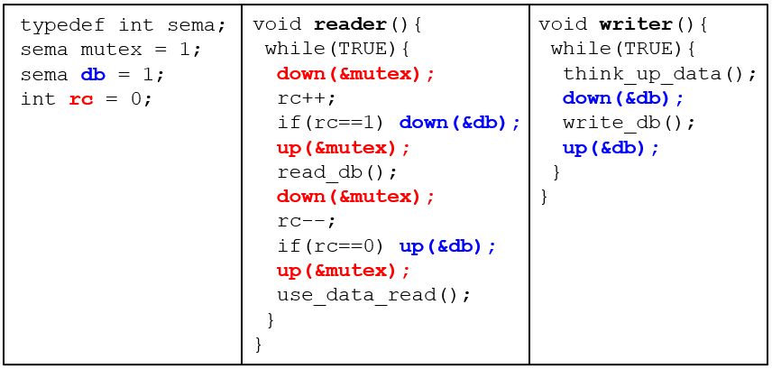
Readers/Writers (1 of 6)
N processes access (i.e., read or write) some shared data
At any given time: R readers or 1 writer allowed. Basic solution:
Notes:
Long Description:
The code from top to bottom is as follows.
type def int sema semicolon
sema mutex equals 1 semicolon
semaphore d b equals 1 semicolon
int r c equals 0 semicolon
void reader left parenthesis void right parenthesis left brace
while left parenthesis TRUE right parenthesis left brace
down left parenthesis ampersand mutex right parenthesis semicolon
r c plus plus semicolon
if left parenthesis r c equals equals 1 right parenthesis down left parenthesis ampersand d b right parenthesis semicolon
up left parenthesis ampersand mutex right parenthesis semicolon
read underscore data underscore base left parenthesis right parenthesis semicolon
down left parenthesis ampersand mutex right parenthesis semicolon
r c minus minus semicolon
if left parenthesis r c equals equals 0 right parenthesis up left parenthesis ampersand d b right parenthesis semicolon
up left parenthesis ampersand mutex right parenthesis semicolon
use underscore data underscore read left parenthesis right parenthesis semicolon
right brace
right brace
void writer left parenthesis right parenthesis
left brace
while left parenthesis TRUE right parenthesis left brace
think underscore up underscore data left right parenthesis semicolon
down left parenthesis ampersand d b right parenthesis semicolon
write underscore d b left parenthesis right parenthesis semicolon
up left parenthesis ampersand d b right parenthesis semicolon forward slash asterisk release exclusive access asterisk forward slash
right brace
right brace

Slide 72
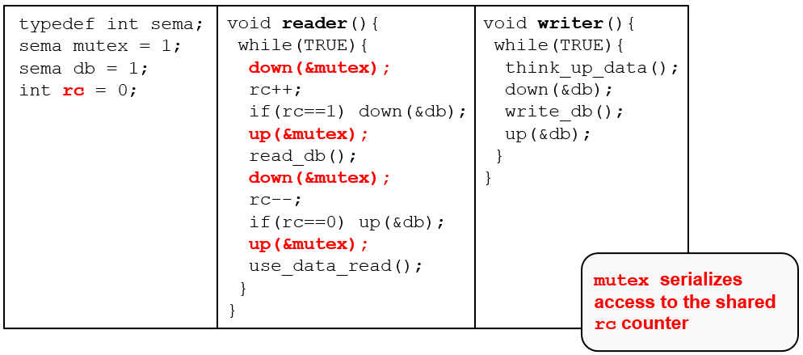
Readers/Writers (2 of 6)
N processes access (i.e., read or write) some shared data
At any given time: R readers or 1 writer allowed. Basic solution:
Notes:
Long Description:
The code from top to bottom is as follows.
type def int sema semicolon
sema mutex equals 1 semicolon
semaphore d b equals 1 semicolon
int r c equals 0 semicolon
void reader left parenthesis void right parenthesis left brace
while left parenthesis TRUE right parenthesis left brace
down left parenthesis ampersand mutex right parenthesis semicolon
r c plus plus semicolon
if left parenthesis r c equals equals 1 right parenthesis down left parenthesis ampersand d b right parenthesis semicolon
up left parenthesis ampersand mutex right parenthesis semicolon
read underscore data underscore base left parenthesis right parenthesis semicolon
down left parenthesis ampersand mutex right parenthesis semicolon
r c minus minus semicolon
if left parenthesis r c equals equals 0 right parenthesis up left parenthesis ampersand d b right parenthesis semicolon
up left parenthesis ampersand mutex right parenthesis semicolon
use underscore data underscore read left parenthesis right parenthesis semicolon
right brace
right brace
void writer left parenthesis right parenthesis
left brace
while left parenthesis TRUE right parenthesis left brace
think underscore up underscore data left right parenthesis semicolon
down left parenthesis ampersand d b right parenthesis semicolon
write underscore d b left parenthesis right parenthesis semicolon
up left parenthesis ampersand d b right parenthesis semicolon forward slash asterisk release exclusive access asterisk forward slash
right brace
right brace
An insert on the bottom right reads mutex serializes access to the shared r cd counter.

